Slide 1
Annyeong Series Character Introduction
The Annyeong Series is a captivating learning tool designed for Korean language learners around the world. It features a diverse cast of characters from various nationalities and backgrounds, making it easy for learners to relate to the characters while exploring the Korean language and culture. Each character embarks on their own Korean language learning journey, providing an engaging and relatable experience that helps learners absorb Korean naturally.
One unique feature of this series is that some characters are presented in multiple versions. Each version brings visual variety and emphasizes the individuality of each character, allowing learners to choose their favorite version or simply enjoy the different styles. This creative approach makes the learning experience even more fun and immersive.
Characters like Sarang, Priya, Haru, Sophia, Yu Tao, Sam, Gabriel, and Jina Ssaem each have their own stories and backgrounds, making Korean learning even more intriguing. These characters reflect multicultural backgrounds, allowing learners worldwide to connect with their experiences. The different versions of the characters also add a layer of immersion, making the learning journey more enjoyable.
Check out the images below to see the diverse versions of each character and make your Korean learning experience even more exciting!

Slide 2
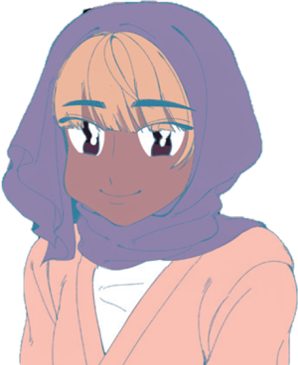
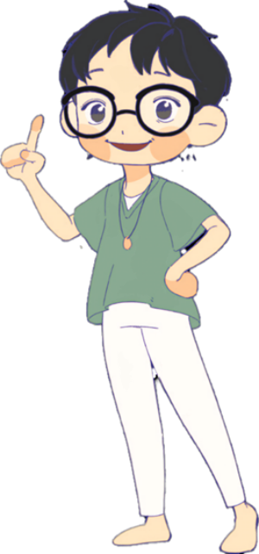
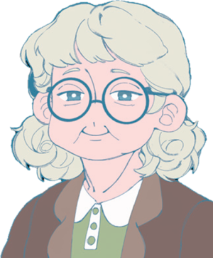
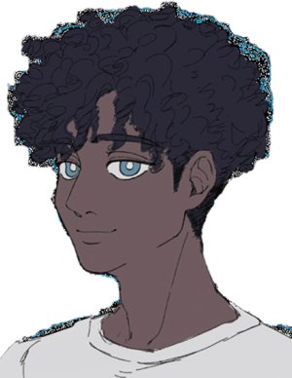
SARANG`S FRIENDS
SARANG`S FRIENDS
SARANG`S FRIENDS
Sarang
Priya
Haru
Sarang shares a flat in Seoul Villa and is the leader of room 101 on the first floor, which has four rooms. When new people arrive, she explains the flat rules. Sarang was born in the UK to a Korean mother and a British father. She spoke Korean well as a child but forgot much of it after living in the UK. She is now back in Korea for a year to study the language and works part-time at the shared apartment.
Priya is very interested in Korean culture because of K-pop. She hopes to work and live in Korea in the future. Priya does not eat pork.
Haru is from Japan and became interested in Korea through Korean dramas. She studies art and has enrolled in a language school to learn Korean. Haru cannot eat spicy food well.
HELLO KOREAN
HELLO KOREAN
HELLO KOREAN
SARANG`S FRIENDS
SARANG`S FRIENDS
SARANG`S FRIENDS
Professor Caroline
Jina Ssaem
Sophia
Professor Caroline or Caroline Ssaem (Teacher), teaches history at a university in the United States. She is fascinated by Korean history and decided to come to Korea for a month after reading Korean novels.
Jina Ssaem is your cheerful Korean teacher in AnnyeongKorean.She’s passionate about languages and loves to cook!With her, you’ll learn Korean and maybe even taste some yummy Korean snacks. Jina-Ssaem makes every lesson feel like a fun adventure!
Sophia is from France and is an Olympic butterfly swimmer. She enjoys swimming in the Han River.
HELLO KOREAN
HELLO KOREAN
HELLO KOREAN
SARANG`S FRIENDS
SARANG`S FRIENDS
SARANG`S FRIENDS
Yu Tao
Sam
Gabriel
Yu Tao is the leader of room 201 on the second floor. He is from China, a mathematics genius, and enjoys playing baduk (a Korean strategy board game) and e-sports.
Sam is from Australia and dreams of becoming a chef. He loves playing football and baseball and often goes to baseball games.
Gabriel is from Canada. His grandfather, a war veteran, inspired his interest in Korea. Gabriel studies architecture and is very interested in hanoks (Korean traditional houses).
HELLO KOREAN
HELLO KOREAN
HELLO KOREAN

Slide 3
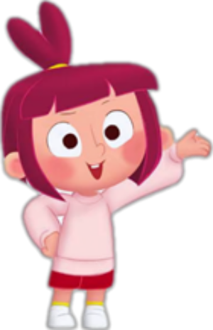
Sarang

Slide 4
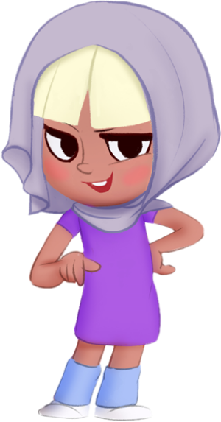
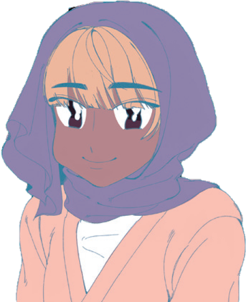
Priya

Slide 5
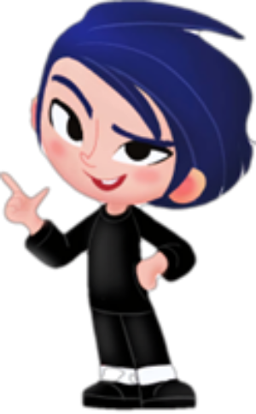
Haru

Slide 6
Sophia

Slide 7
Yu Tao

Slide 8
Sam

Slide 9
Jina Ssaem

